Slide 1

Cover page
(Justina)

Slide 2
OUTLINE
INTRODUCTION
RECOMMENDATION
GENERAL figures
Deeper dive into HIGH-END TECH products
CONCLUSION

Slide 3
Should ENIAC sign a deal with MAGIST?
🇩🇪 ✈️ 🇧🇷 🟰 🤑💸⁉️
Notes:
Set expectations and meet them during the presentation (outline)

Slide 4
YES:
ONE YEAR TRIAL DEAL
Notes:
Tight dense text, hard to read.
Reorganize the slide.
Key words and bullet points.
Figures related to revenues are looking positive, and there is improvement through the years.
However, there is a problem with delivery time. The difference between estimated delivery time and actual delivery time is on average 11 days. This delay can cost the company some customers and therefore profit. It is important to note that delivery delay has decreased significantly throughout the years.
Our recommendation is to give Magist a one-year trial to see if they will do better on delivery time, and revisit the deal by the end of the trial.

Slide 5
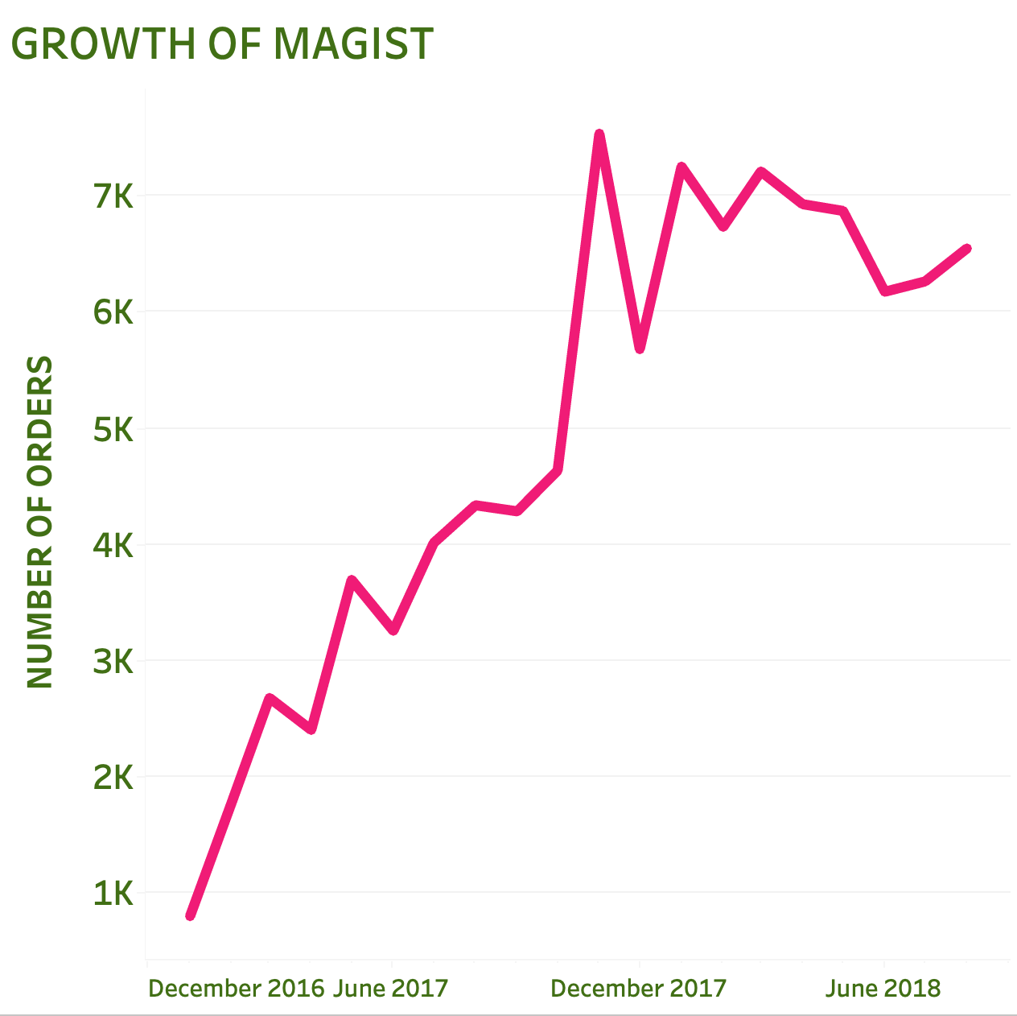
MAGIST’s POPULARITY GREW BY 19% (2017-2O18)
Notes:
Too simple, break it down monthly

Slide 6
General figures

Slide 7
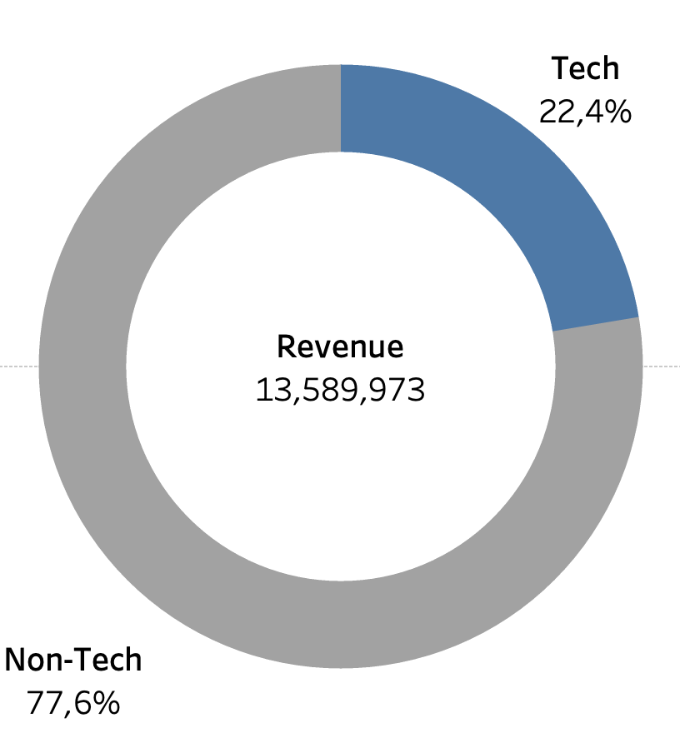
Almost 1/4 of the company’s total revenues comes from tech categories.
Notes:
We were curious about whether magist has experience with tech companies, so we looked into it and it shows ..

Slide 8
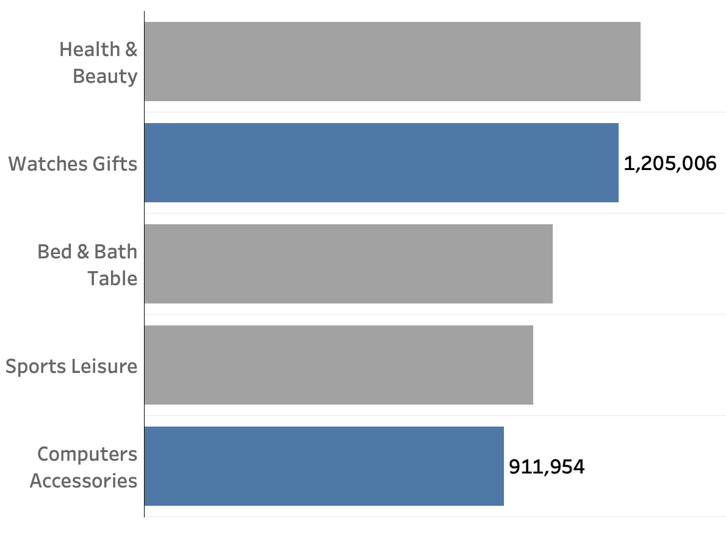
Out of the 5 best performing categories, two belong to tech.
Notes:
Text too small
Same method as the slide before
It might be irrelevant

Slide 9
Insights

Slide 10
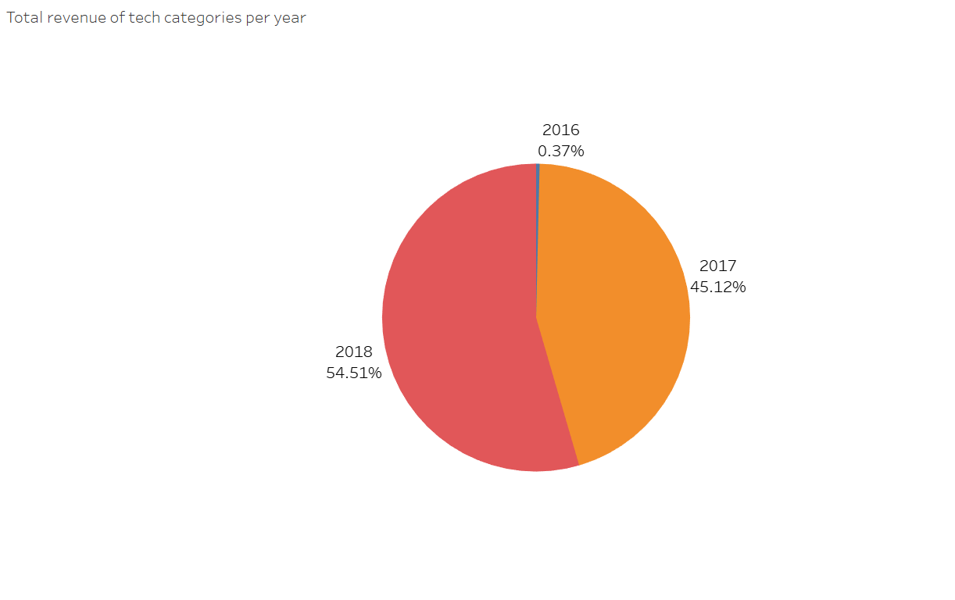
Significant growth in sales for the year 2018
Notes:
Text too small and not labeled
Growth would be better with line chart or bar chart

Slide 11
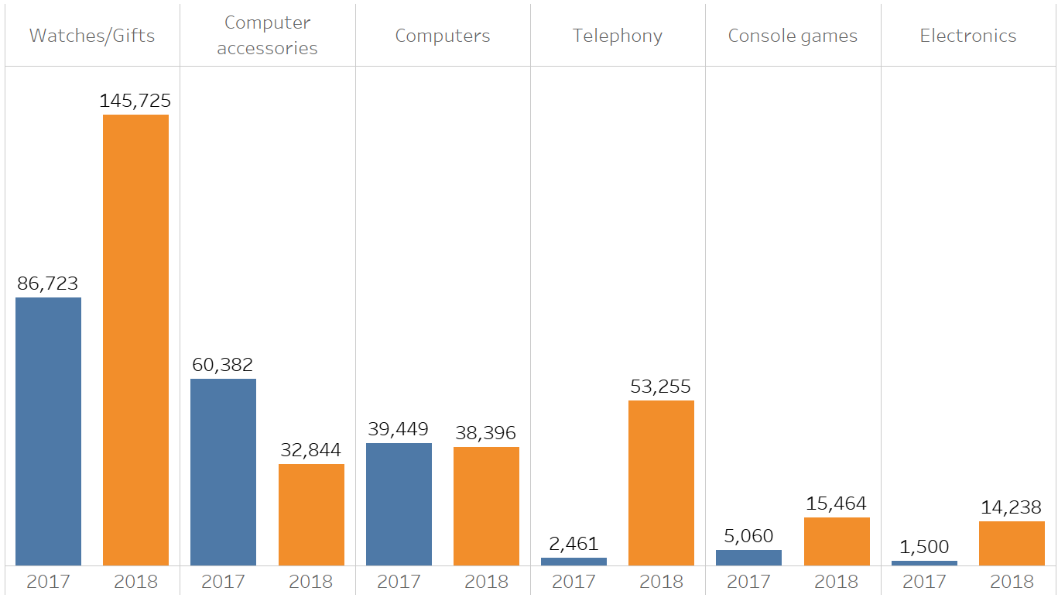
Increase of revenue of high end tech products from 2017 - 2018
Notes:
Hard to follow what we’re looking at and why, start with its relation to the decision to be relevant

Slide 12
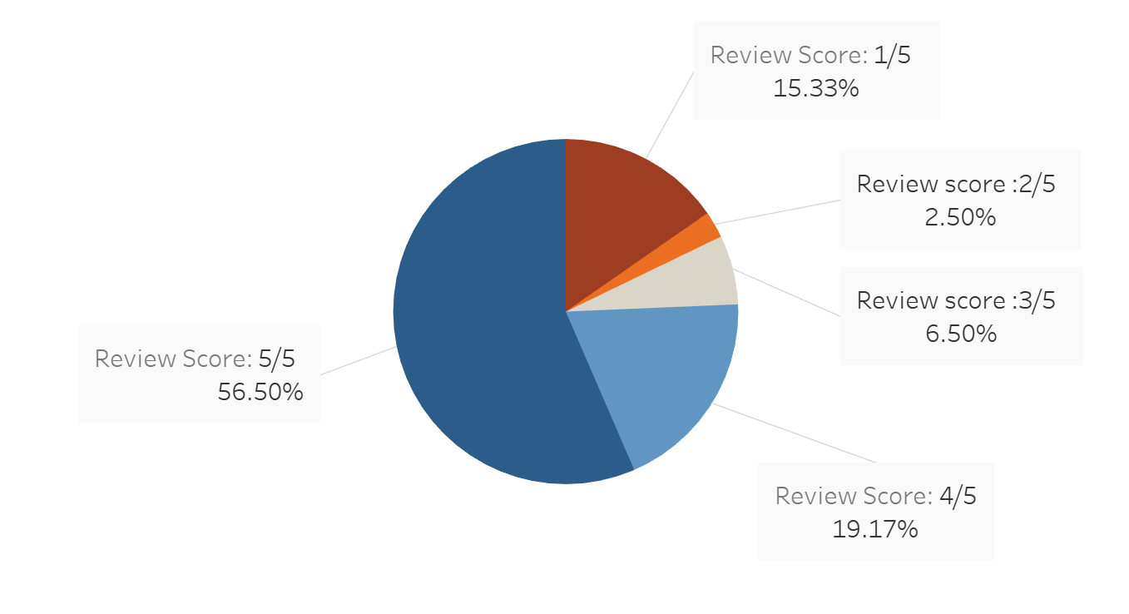
More than 75 % of customers are satisfied this their orders
Notes:
Text too small and not labeled
Growth would be better with line chart or bar chart

Slide 13
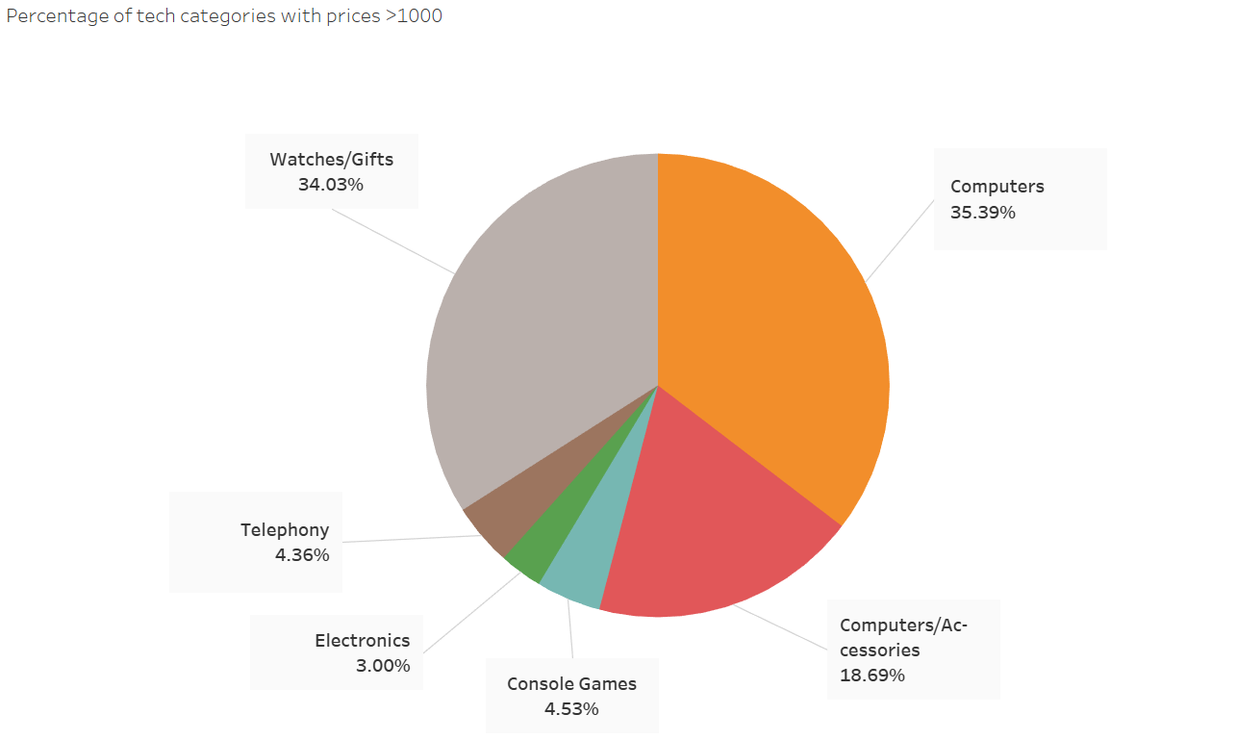
Top performing high end tech products:
Notes:
Hard to follow what we’re looking at and why, start with its relation to the decision to be relevant

Slide 14
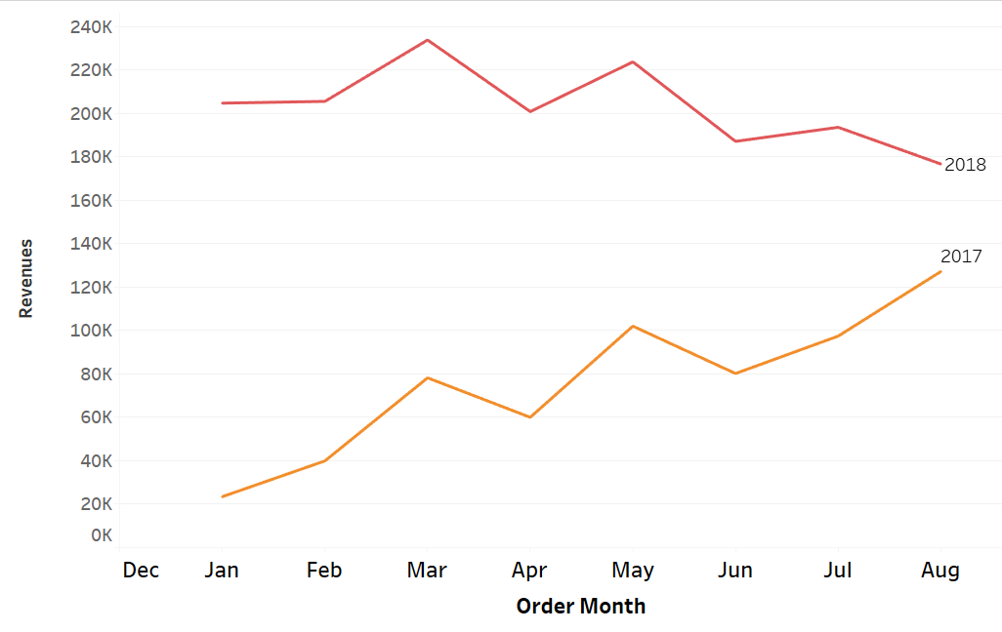
Revenues 2017 - 2018
Revenue
Growth in 2017
Decline in 2018
Notes:
We decided to dig deeper into sales months of our top 6 performing tech products. There is no question that revenues in 2018 are much higher than in 2017. However, looking at the pattern and the trends, we see a positive performance for the year 2017, with a noticeable decline for revenues in 2018.

Slide 15
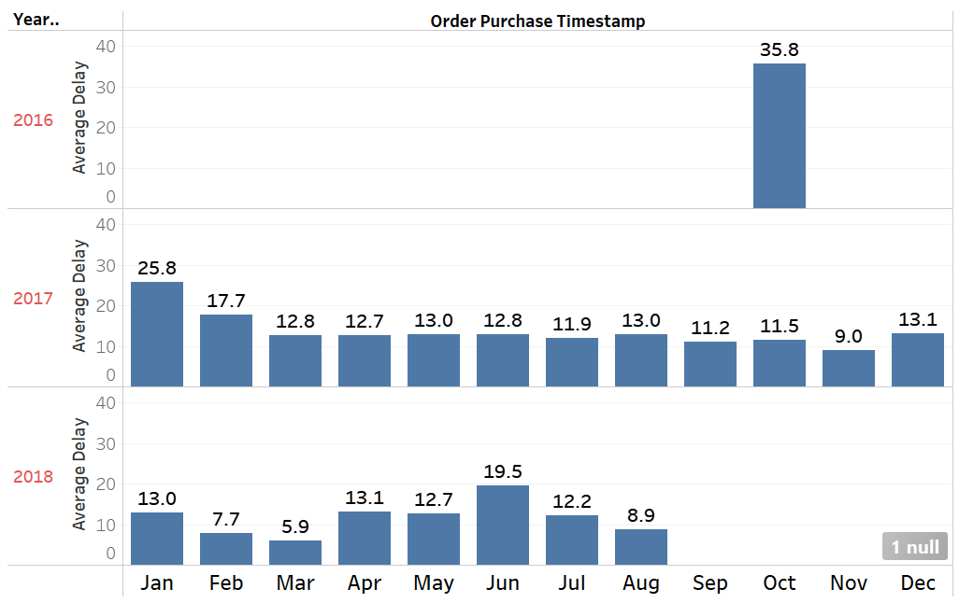
Delivery
Total average delay in delivery is 14 days
Notes:
Delivery time is important for our company as it can cost us customers. This is why we looked into figures related to the average delivery delay over the years. Magist is not showing much promise here with a total average of 14 days delay, but it is obvious that they are performing much better throughout the years.

Slide 16
Conclusions
SALES are improving
DELIVERY TIME is long, but improving
Notes:
MAGIST is a rapidly growing company in Brazil with a strong market presence in TECH sector
The company’s revenue from TECH is growing over years but recent patterns tell us to be careful.
MAGIST is improving its delivery services
More than 75% of customers are SATISFIED

Slide 17
Why Magist is a good choice?
MAGIST is a rapidly growing company in Brazil
MAGIST established a strong market presence in TECH sector
The company’s revenue from TECH is growing over years
MAGIST is improving its delivery services
More than 75% of customers are SATISFIED

Slide 18
Cover page
(Justina)
Thank you! 🚀

Slide 19
Deliverables (questions to answer)
Eniac’s catalogue is 100% tech products and heavily based on Apple-compatible accessories. It is not clear that Magist is a good partner for these high-end tech products.
Among Eniac’s efforts to have happy customers, fast deliveries are key. The delivery fees resulting from Magist’s deal with the public Post Office might be cheap, but at what cost? Are deliveries fast enough?

Slide 20
Deliverables (presentation)
1. Scope: The main purpose of the presentation is to recommend whether or not to sign the deal with Magist. Your recommendation should be based on a clear story created from the information you get from the given dataset and your own research about the Brazilian market, like current trends, business opportunities, and competitors.
2. Format: You can prepare a presentation on any software of your choice, as long as it offers online collaborative editing so that the whole group can work on it at the same time. We strongly recommend Google Slides, Canva, or Prezi. These platforms offer a variety of templates and built-in themes, which can help you to create a professional-looking presentation without investing substantial time in design choices.You may also display your Tableau plots directly, ensuring they are clearly legible on your shared screen.
3. Time limit: Aim for a 3-4 minute presentation, with a hard limit of 5 minutes. The instructor will enforce this limit strictly, so practice beforehand to ensure timing accuracy.

Slide 21
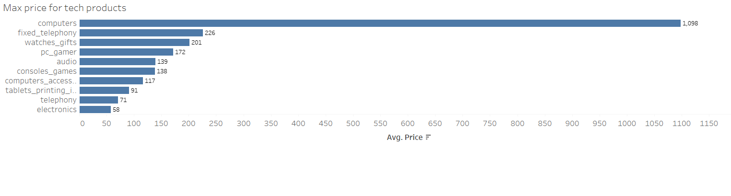
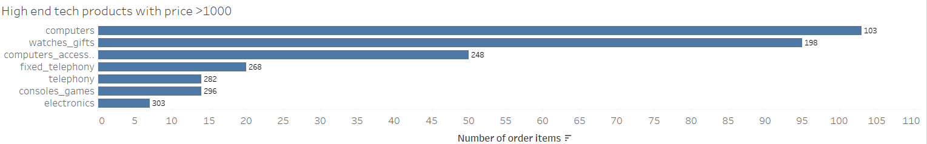

Slide 22
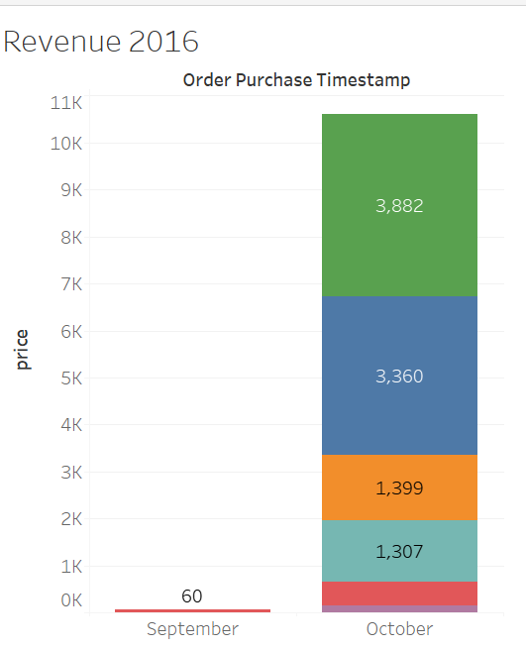
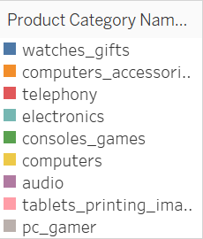

Slide 23
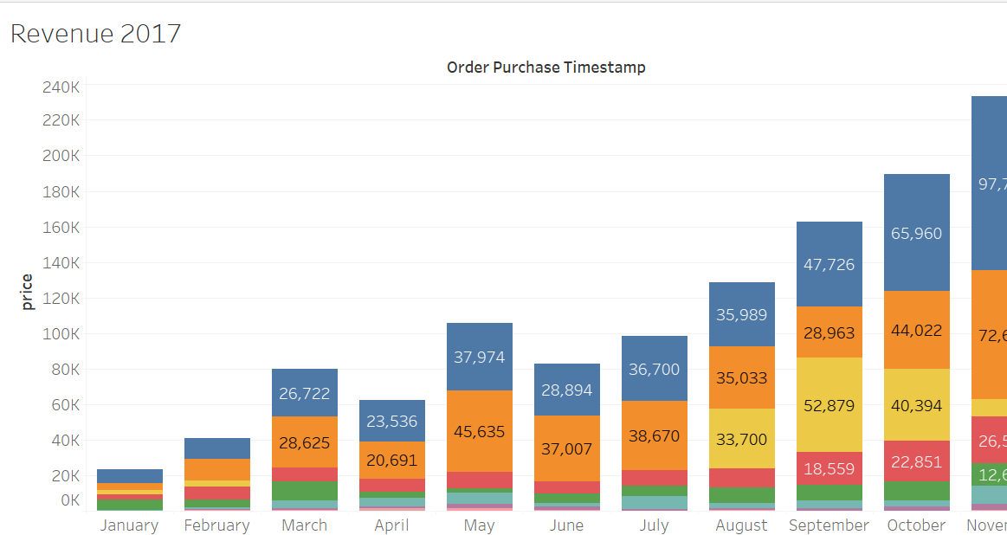
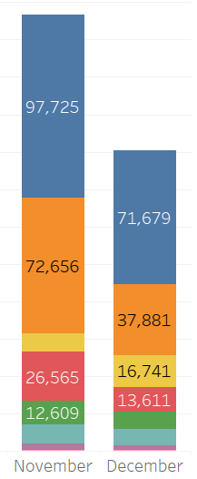

Slide 24
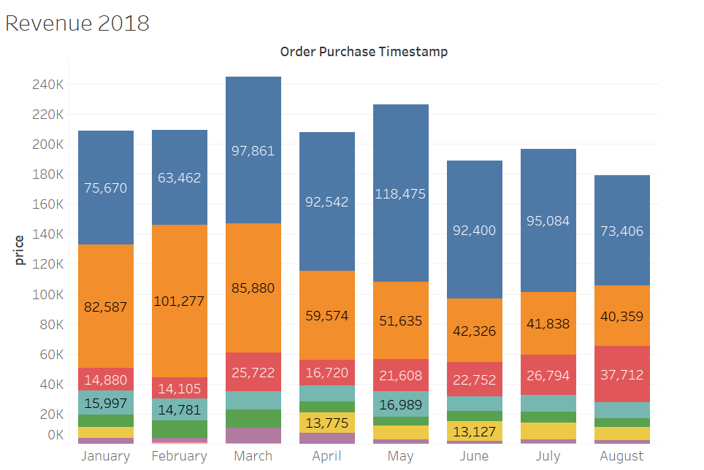

Slide 25
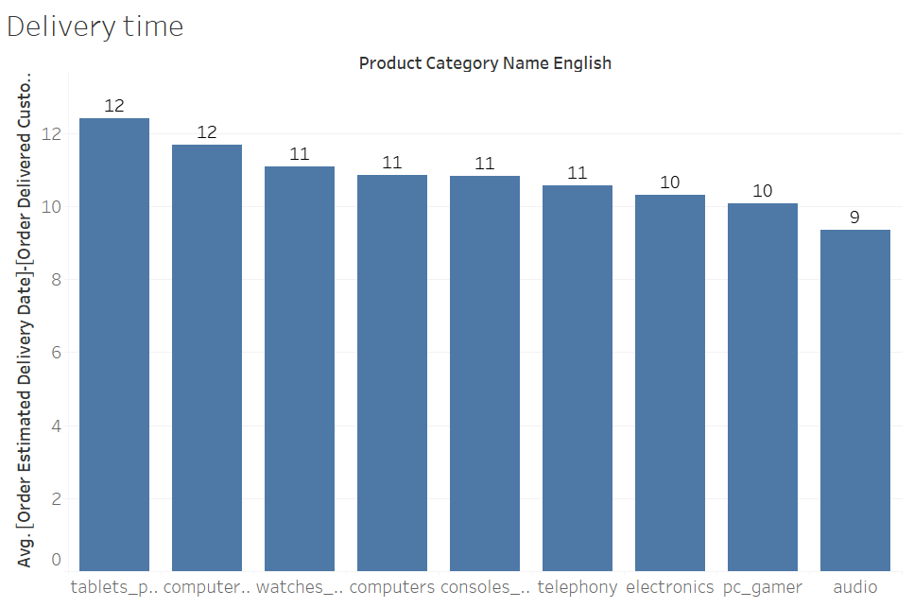

Slide 26
Notes
Tech products sold represent 15% of overall products, but tech revenues represent 22% of total revenues
Two tech category are among Magist’s top 5 2018 best sold categories, which might question their tech expertise
In 2016, Magist sold tech products only during september and october.
There is a peak of sales in tech products in november 2018.

Slide 27
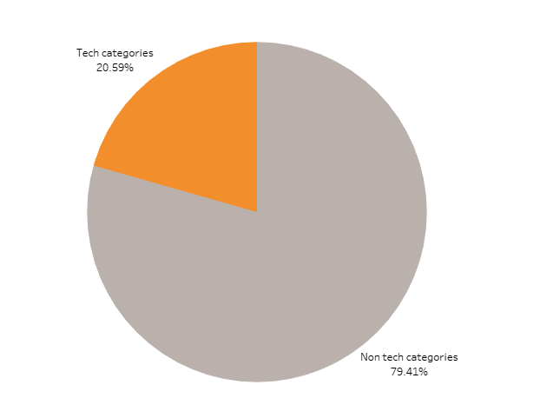

Slide 28
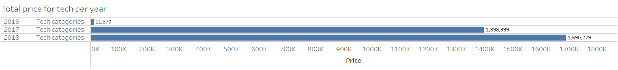

Slide 29
